Slide 1

Operations Dashboard Process Flow
1. Business Understanding
2. Data Understanding
3. Data Pipelines Design
4. Implementation
5. Testing
Identify business problems – Estimates Business Operations Hours
Complete Data Validation & Data Verification with data consumptions, data issues, and data strategy (ETL vs ELT vs ETLT)
.
Simple Python Solution Architecture has been attached
Implement simple python solution
Unit Testing, not overed Integration Testing and End-to-End Testing
10. Document
9. Collect Feedback – Agile
8.Monitor
7. Deployment & Schedule
6. Data Visualization
Maintain document regularly
Continues collect feedback
Continues monitor performance
Report Automation
Design metrics and create Power BI report

Slide 2
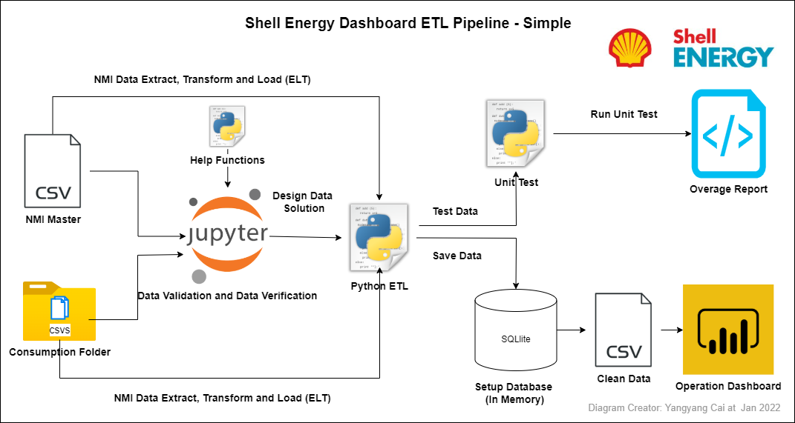
Simple Solution – Python, SQL, Power BI

Slide 3
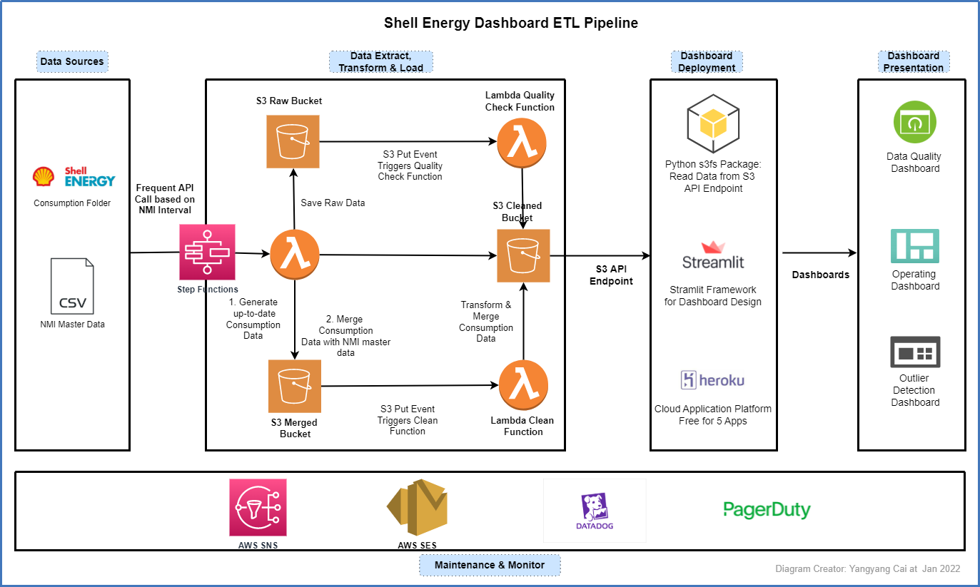
Cloud Solution on AWS

